Slide 1
Regression
(3 of 4)
Jeanette Mumford
Notes:
10.5 min

Slide 2
Place to ask questions
(anonymous, but be polite)
tinyurl.com/questions-for-jeanette

Slide 3
Goals
Introduce contrasts of parameter estimates
Practice a little
That’s it!

Slide 4
Why do we need contrasts?
The t-stats (z-stats) we estimate correspond to the contrasts we specify
  Contrasts link our hypotheses to our statistics!

Slide 5
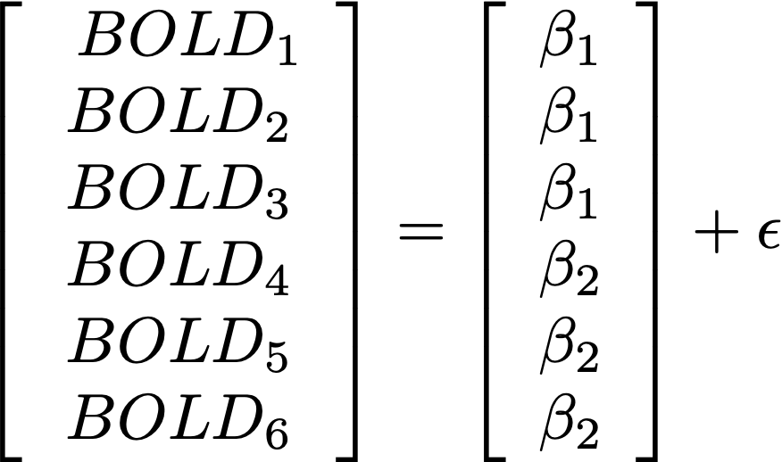
How do we test a group difference?
Contrasts

Slide 6
Contrasts: General idea
Start with a contrast statement for your hypothesis (in betas)
Rearrange so you have “something” > 0
Find a vector, c, so cB = “something”

Slide 7
Contrasts: General idea
Start with a contrast statement for your hypothesis (in betas)
Rearrange so you have “something” > 0
Find a vector, c, so cB = “something”
Is G1 > G2?
(B1 > B2)
B1 - B2 > 0
c = [1 -1] (cB) = B1 - B2
IMPORTANT
Use > not <!
For B1<B2 you’d use B2 > B1

Slide 8
Simple linear regression
Positive age effect?
Negative age effect?

Slide 9
Simple linear regression
Positive age effect? c = [0, 1]
Negative age effect? c = [0, -1]

Slide 10
1-way ANOVA with 3 levels
G1 > G2?
G2 > G3?
G1 > G3?

Slide 11
1-way ANOVA with 3 levels
G1 > G2? c = [1 -1 0]
G2 > G3? c = [0 1 -1]
G1 > G3? c = [1 0 -1]

Slide 12
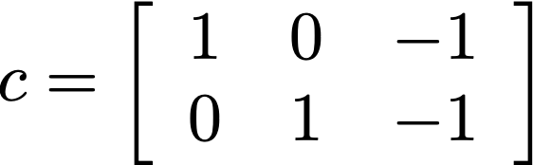
What about F-tests?
F-test is any group comparison different from 0?
  Is G1=G3 or G2 = G3?
    Note: it is redundant to then test if G1=G3 or G2=G1
F-tests simultaneously test multiple contrasts
  Contrast matrix

Slide 13
F-tests are omnibus tests
If the F-test is significant, then the separate t-tests are used to figure out what the F-test found
One F-test can be used in place of many t-tests, so should be used to cut down on multiple comparisons
  Eg if my f-test isn’t significant, I have no reason to then look at the 3 group comparisons!

Slide 14
That’s it!

